Slide 1
CAR PRICE ANALYSIS
REINFORCEMENT-4 POWER BI
PRESENTED BY:
JOTHEESWARAN S
DA&DS-FEB’25
04-06-2025

Slide 2
Agenda
Introduction to Dataset
Data Preparation
Visualizations
Key Insights
Recommendations
Conclusion

Slide 3

INTRODUCTION TO DATASET
This is an dataset of various car along with their name, brand, engine type and price over the years, which appears to be used for predicting car prices based on various attributes.

Slide 4

DATA-BASE COLUMNS
Car ID
Brand Year
Engine size
Fuel type
Transmission
Mileage
Condition
Price
Model

Slide 5
DATA PREPARATION
Power BI Power Query – Import & Basic Cleaning
Import Data - Home → Get Data → Choose source → Load or Transform.
Remove Duplicates - Home → Remove Rows → Remove Duplicates.
Remove Nulls - Home → Remove Rows → Remove Blank Row
Check Data Types - Transform → Data Type → Set correct types (Text, Number, Date).
Apply Changes -Home → Close & Apply.

Slide 6
DAX FUNCTIONS
VEHICLE TYPE –Categorize the Vehicle type as SUV , Sedan ,…etc
BRAND & MODEL –Concatenate the Brand and Model Columns
ENGINE CATEGORY –Categorize the Engine type Based on Litres
LUXURY CATEGORY – Separate them as luxury and non-luxury category
YEAR ORDER – Grouped the year as Four-year format
YEAR GROUP – Named the grouped Four years as 1,2,3,……6
MAJOR CACULATIONS– Average, Total Price of all Values

Slide 7
VISUALIZATION
DASHBOARD

Slide 8
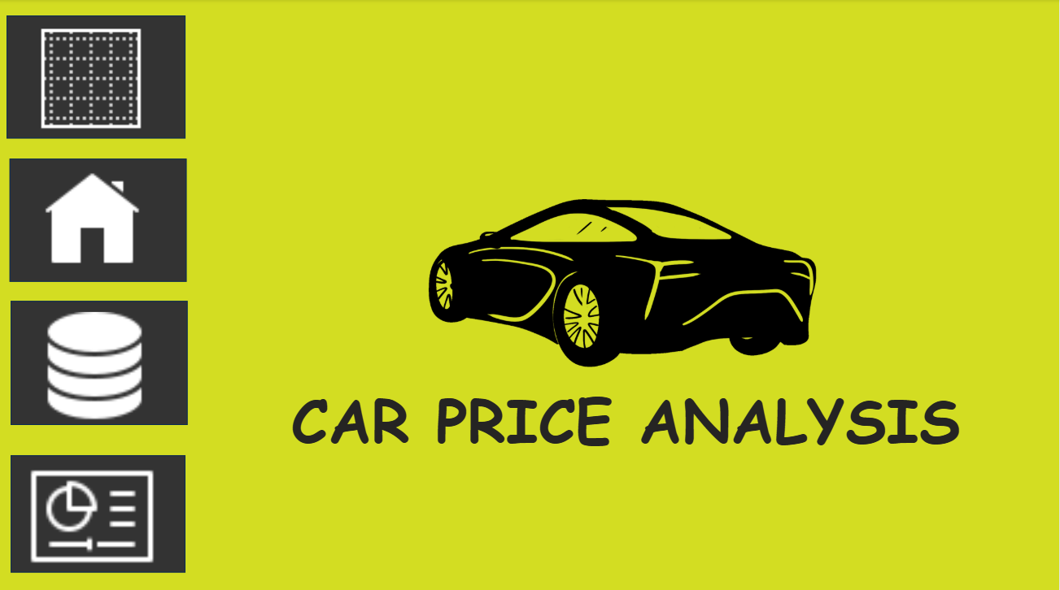
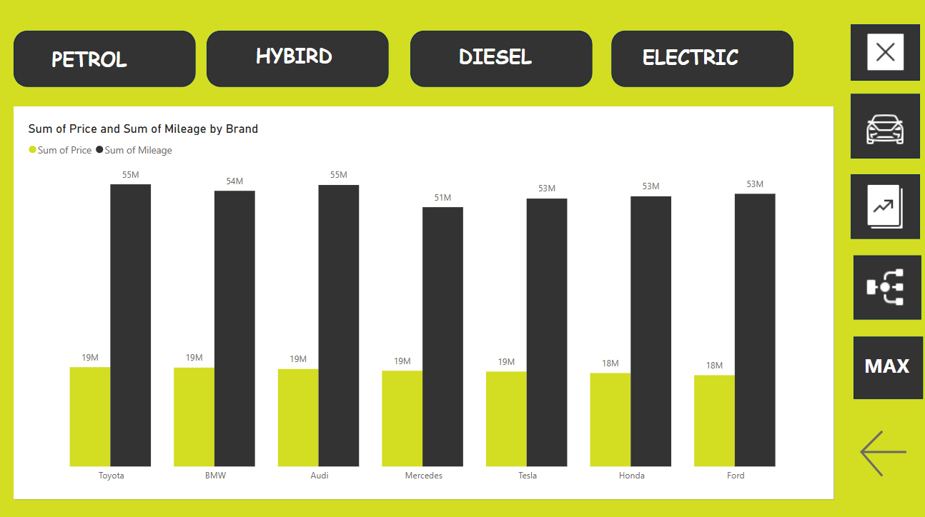
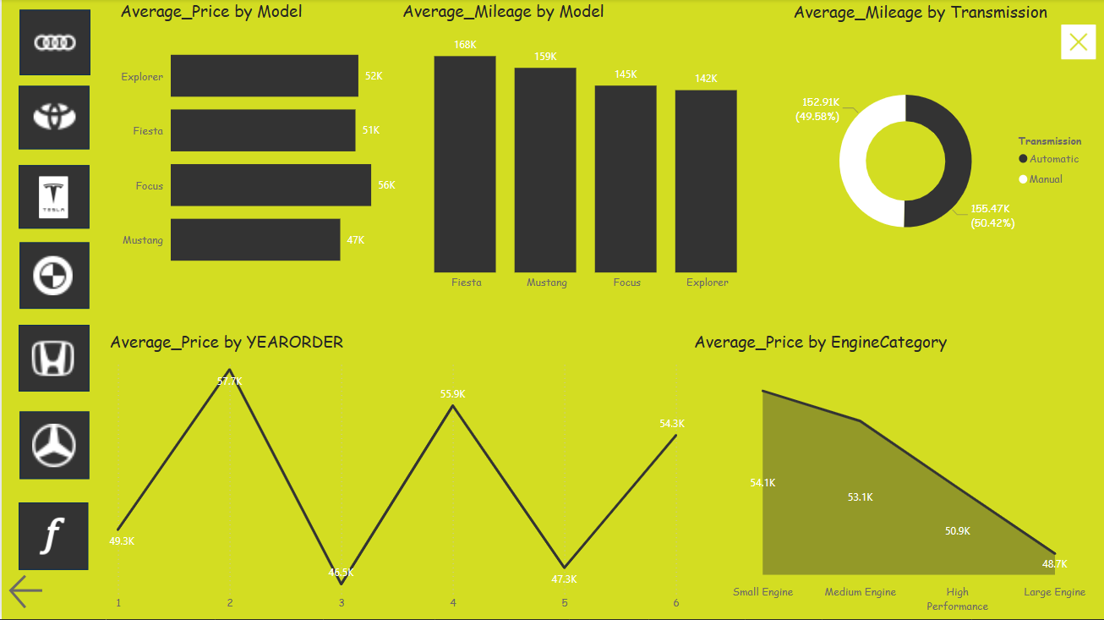
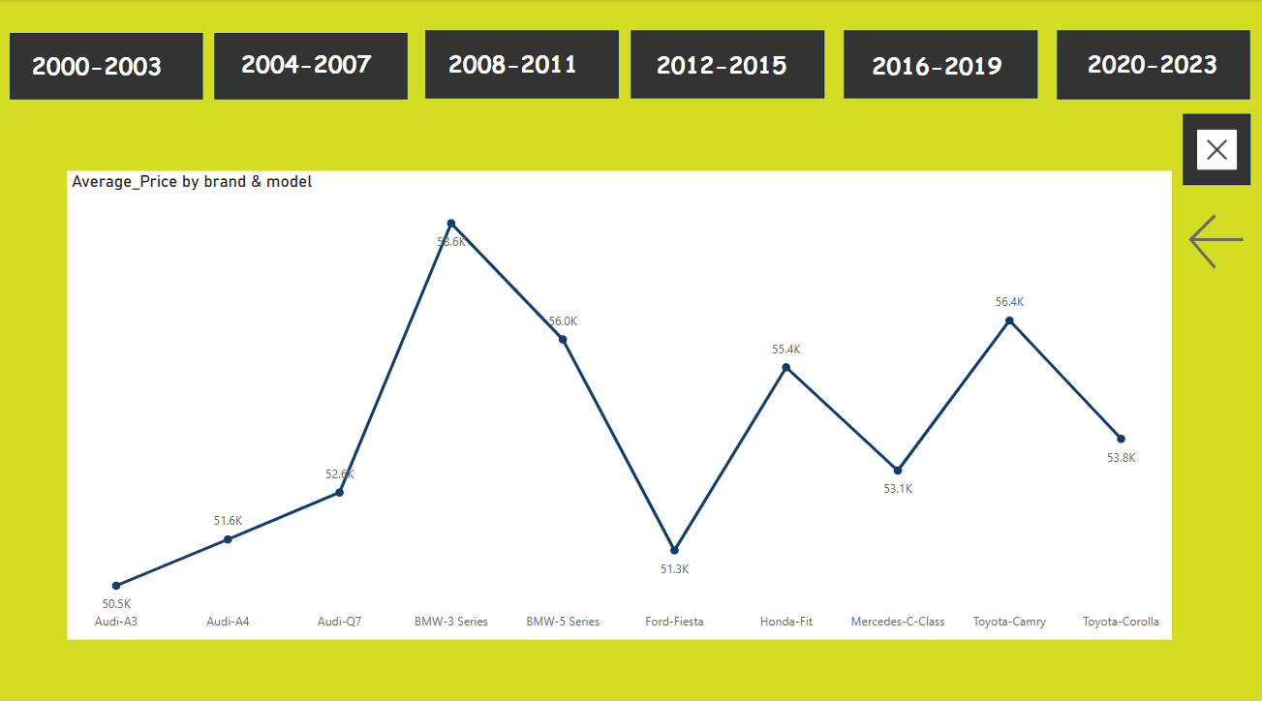

Slide 9
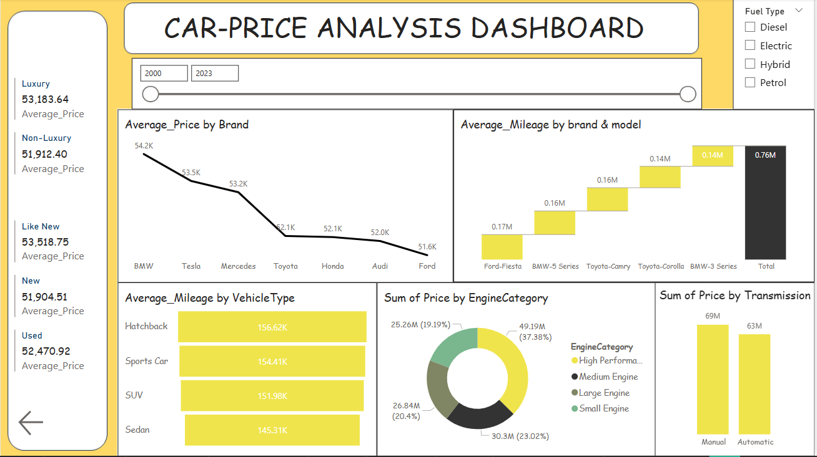

Slide 10
Luxury vs Non-Luxury Cars
Luxury cars cost only slightly more (~$1,270) than non-luxury ones.
"Like New" cars are priced higher than "New" ones, likely due to better models.
Brand-Based Pricing
BMW, Tesla, and Mercedes have the highest average prices.
Ford is the most affordable, showing value positioning.
Mileage Patterns
Ford Fiesta and BMW 5 Series show high mileage, yet BMW holds value.
Hatchbacks have the most mileage; sedans the least.
Engine & Performance
High-performance engines contribute the most to total price.
Small and medium engines also have a strong market share.
Transmission Preferences
Manual cars have a slightly higher total price than automatic ones.
Indicates a balance between performance and comfort.
KEY
INSIGHTS

Slide 11
2000–2003 Audi A4 had the highest price. Tesla X is likely incorrect data. Prices were close across all models. | 2012–2015 BMW 5 Series topped the chart. Ford Fiesta was the cheapest. Tesla Y priced higher than Model S.
2004–2007 Tesla 3 price looks like an error. Mercedes C-Class had the lowest price. Most cars had similar prices around 60K. | 2016–2019 Mercedes E-Class was the highest. Honda CR-V was the lowest. Toyota Corolla had a good mid-range price.
2008–2011 BMW 5 Series was the most expensive. Tesla X again seems misplaced. Prices were steady for most models. | 2020–2023 Mercedes C-Class led in price. Audi A4 was the most affordable. Tesla and Toyota models had strong pricing.

Slide 12
RECOMMENDATIONS
Invest in EVs
Tesla’s strong price retention suggests good ROI in EV models and infrastructure.
Boost Luxury Differentiation
Narrow price gap → add premium features & strong after-sales support.
Focus on Smart SUVs
Prioritize fuel-efficient and hybrid SUV models to match market trends.
Automatic is the Future
Manual cars hold value, but automatics will likely stay dominant.
Support Budget Brands
Ford, Toyota, and Honda stay strong—offer good financing to retain buyers.

Slide 13
CONCLUSION
Luxury cars hold value well but face strong competition from premium non-luxury brands.
EVs like Tesla are gaining popularity and retain high resale value.
SUVs remain top choice with strong pricing and market demand.
Toyota, Honda, and Ford show stable performance and appeal to value-seeking buyers.
Mileage matters—higher mileage lowers price, but luxury cars retain value even with lower usage.
EVs & Hybrids are on the rise, while diesel and petrol may decline.
Automatic cars are overtaking manuals, though both still have a market.
Future trends point to EV growth, expanding luxury options, and continued SUV dominance.

Slide 14
THANK YOU!

